Slide 1
OPEN ELECTIVE OCS1903-PROGRAMMING USING PYTHON WEEK 2

Slide 2
CONTENTS
Python Basics
Comments
Print
User Input
Variables
Datatypes
Operators

Slide 3


Python Basics-Comments
Comments are used for documenting the code .
Comment lines will not be executed by the python interpreter.
Multiline statements:
result=(2*5)+
9
result=(2+3)*(7+8)\
*(9+10)
result=(2*4*
4)
(Acceptable for all kinds of brackets)
Single Line Comment:
#This is a single line comment
Multi-line Comment:
“”” This is multiple ”””

Slide 4
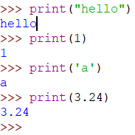
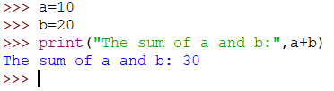


Python Basics-Print statement
To display output on the screen of the user

Slide 5
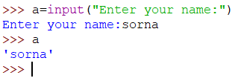

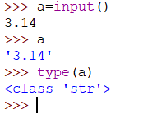


Python Basics-User Input statement
To get user input through keyboard
All inputs got from the user are treated as Strings

Slide 6
Python –Fundamental Components
Operators
Identifiers
Variables
Datatypes

Slide 7
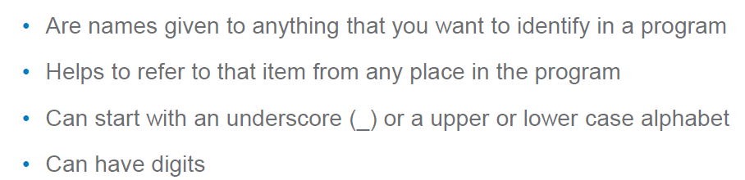
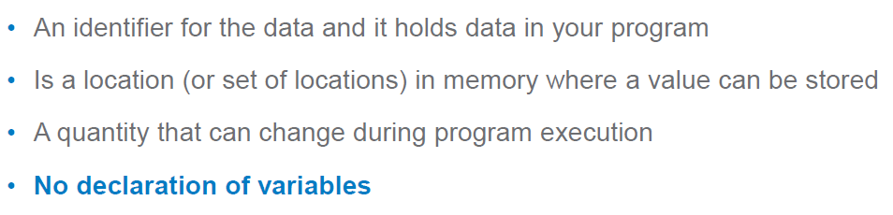
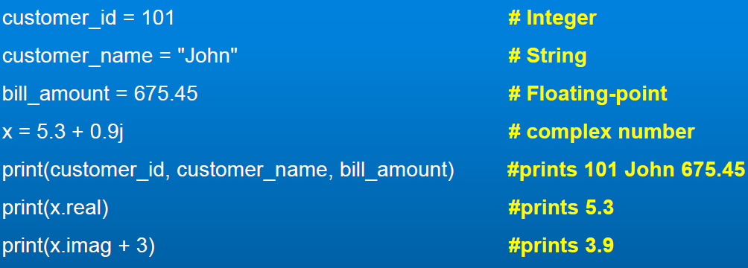
Identifiers
Variables
Case-Sensitive
Cannot match keywords
Eg : Bill_id
_billid1

Slide 8
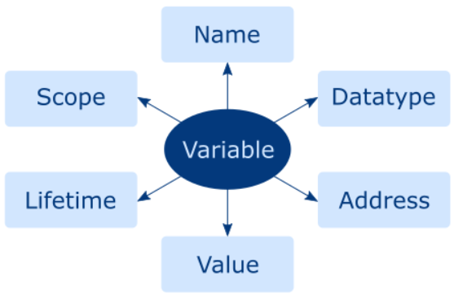
Variables and its dimensions
Identify the variable
Specify where it can be accessed
Determine type , memory required and operations that can be performed on it
Specify how long it will be stored in memory
Specify where it is stored
Data held by the variable

Slide 9
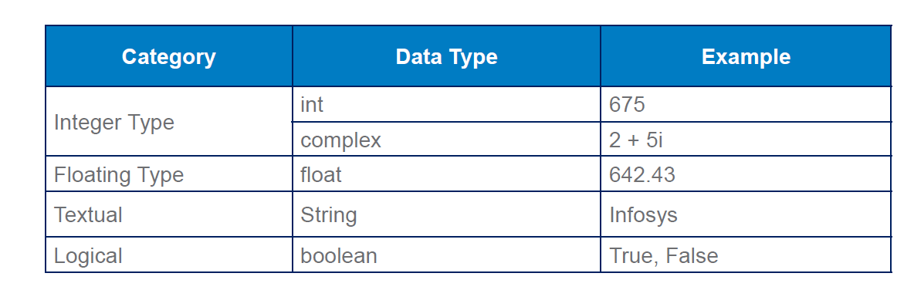
Datatypes

Slide 10
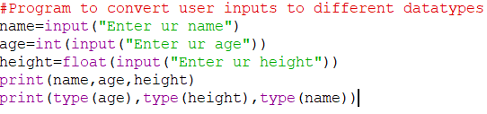
Built-in functions
For handling different types of user inputs
int()-returns a integer number
float()-returns a decimal/floating point number
bool()-returns a Boolean value
complex()-returns a complex number
str()-returns a string

Slide 11

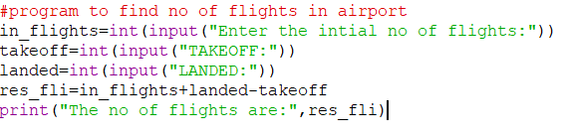
Simple Python codes

Slide 12
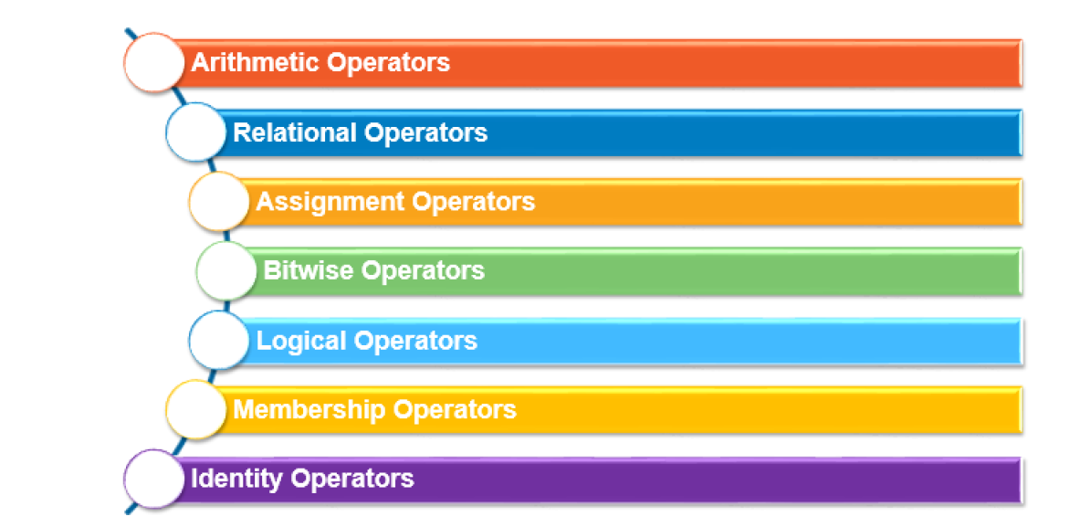
Operators

Slide 13
Arithmetic Operators
An arithmetic operator is a mathematical operator that takes two operands and performs a calculation on them. They are used for simple arithmetic.

Slide 14
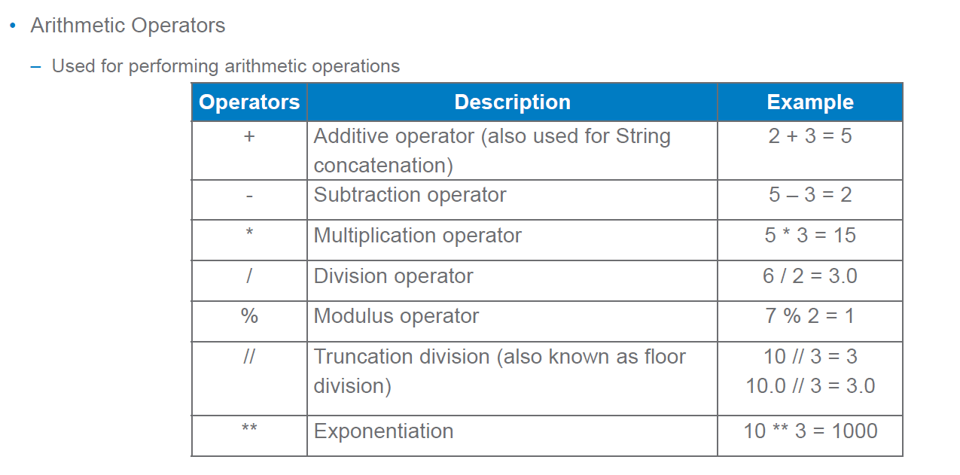
Arithmetic Operators

Slide 15
#Demo Program to test Arithmetic Operators
a=100
b=10
print ("The Sum = ",a+b)
print ("The Difference = ",a-b)
print ("The Product = ",a*b)
print ("The Quotient = ",a/b)
print ("The Remainder = ",a%30)
print ("The Exponent = ",a**2)
print ("The Floor Division =",a//30)
#Program End

Slide 16
Output:
The Sum = 110
The Difference = 90
The Product = 1000
The Quotient = 10.0
The Remainder = 10
The Exponent = 10000
The Floor Division = 3

Slide 17
Relational or Comparative operators
A Relational operator is also called as Comparative operator which checks the relationship between two operands. If the relation is true, it returns True; otherwise it returns False

Slide 18
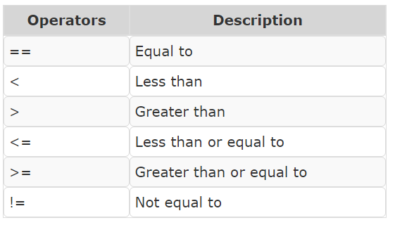
Relational Operators

Slide 19
#Demo Program to test Relational Operators
a=int (input("Enter a Value for A:"))
b=int (input("Enter a Value for B:"))
print ("A = ",a," and B = ",b)
print ("The a==b = ",a==b)
print ("The a > b = ",a>b)
print ("The a < b = ",a<b)
print ("The a >= b = ",a>=b)
print ("The a <= b = ",a<=0)
print ("The a != b = ",a!=b)
#Program End

Slide 20
Output:
Enter a Value for A:35
Enter a Value for B:56
A = 35 and B = 56
The a==b = False
The a > b = False
The a < b = True
The a >= b = False
The a <= b = False
The a != b = True

Slide 21
Logical operators
In python, Logical operators are used to perform logical operations on the given relational expressions. There are three logical operators they are and, or and not

Slide 22
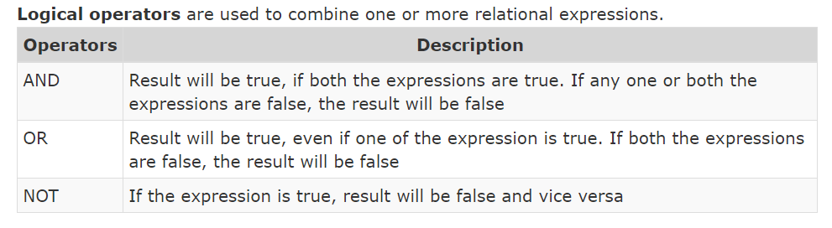
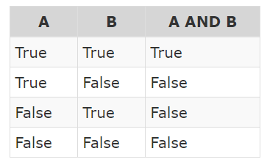
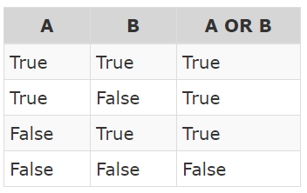
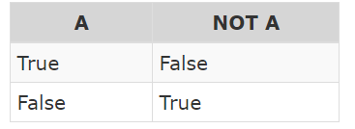
Logical Operators
If A=(m>200), B=(m>300)

Slide 23
#Demo Program to test Logical Operators
a=int (input("Enter a Value for A:"))
b=int (input("Enter a Value for B:"))
print ("A = ",a, " and b = ",b)
print ("The a > b or a == b = ",a>b or a==b)
print ("The a > b and a == b = ",a>b and a==b)
print ("The not a > b = ",not a>b)
#Program End

Slide 24
Enter a Value for A:50
Enter a Value for B:40
A = 50 and b = 40
The a > b or a == b = True
The a > b and a == b = False
The not a > b = False

Slide 25
ASSIGNMENT OPERATORS
In Python, = is a simple assignment operator to assign values to variable. Let a = 5 and b = 10 assigns the value 5 to a and 10 to b these two assignment statement can also be given as a,b=5,10 that assigns the value 5 and 10 on the right to the variables a and b respectively.
There are various compound operators in Python like +=, -=, *=, /=, %=, **= and //= are also available.

Slide 26
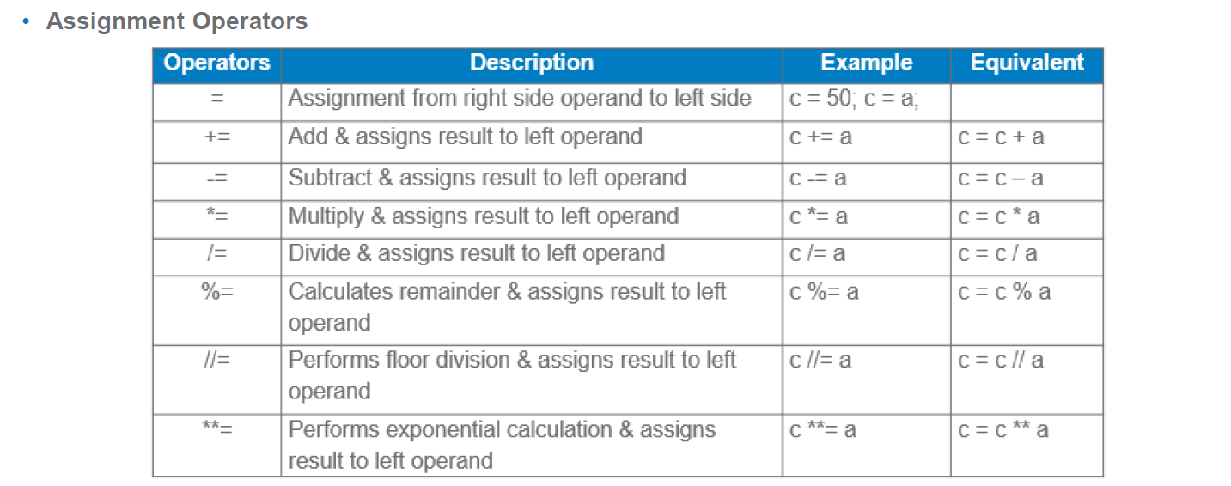
Assignment Operators

Slide 27
#Demo Program to test Assignment Operators
x=int (input("Type a Value for X : "))
print ("X = ",x)
print ("The x is =",x)
x+=20
print ("The x += 20 is =",x)
x-=5
print ("The x -= 5 is = ",x)
x*=5

Slide 28
print ("The x *= 5 is = ",x)
x/=2
print ("The x /= 2 is = ",x)
x%=3
print ("The x %= 3 is = ",x)
x**=2
print ("The x **= 2 is = ",x)
x//=3
print ("The x //= 3 is = ",x)
#Program End

Slide 29
Type a Value for X : 10
X = 10
The x is = 10
The x += 20 is = 30
The x -= 5 is = 25
The x *= 5 is = 125
The x /= 2 is = 62.5
The x %= 3 is = 2.5
The x **= 2 is = 6.25
The x //= 3 is = 2.0

Slide 30
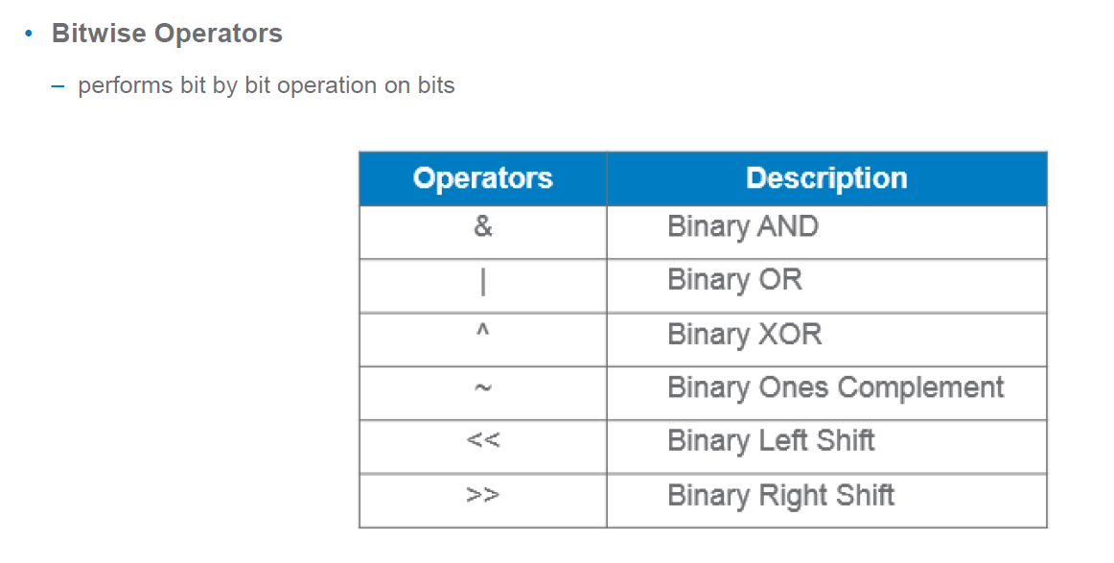
Bitwise Operators

Slide 31
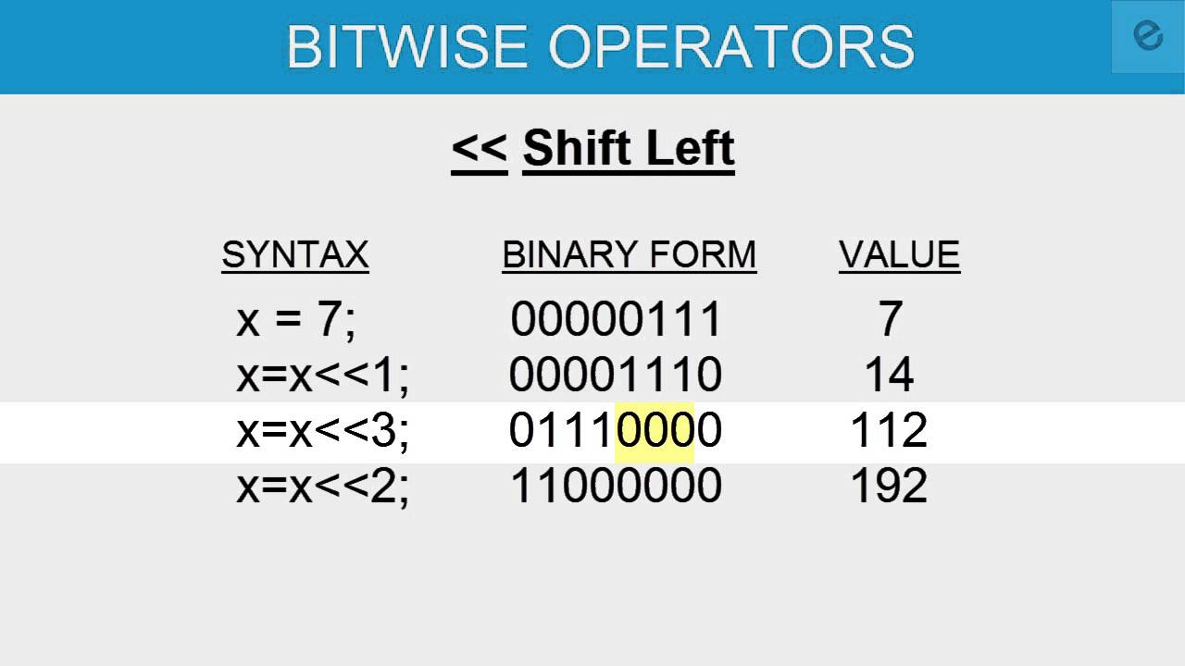
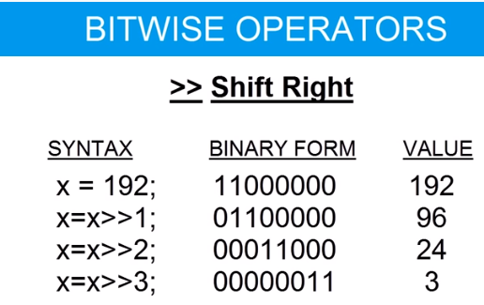
Shifts
We can also use a formula to find the answer,
x<<y=x*2^{y}
We can also use a formula to find the answer,
x>>y=x/2^{y}

Slide 32
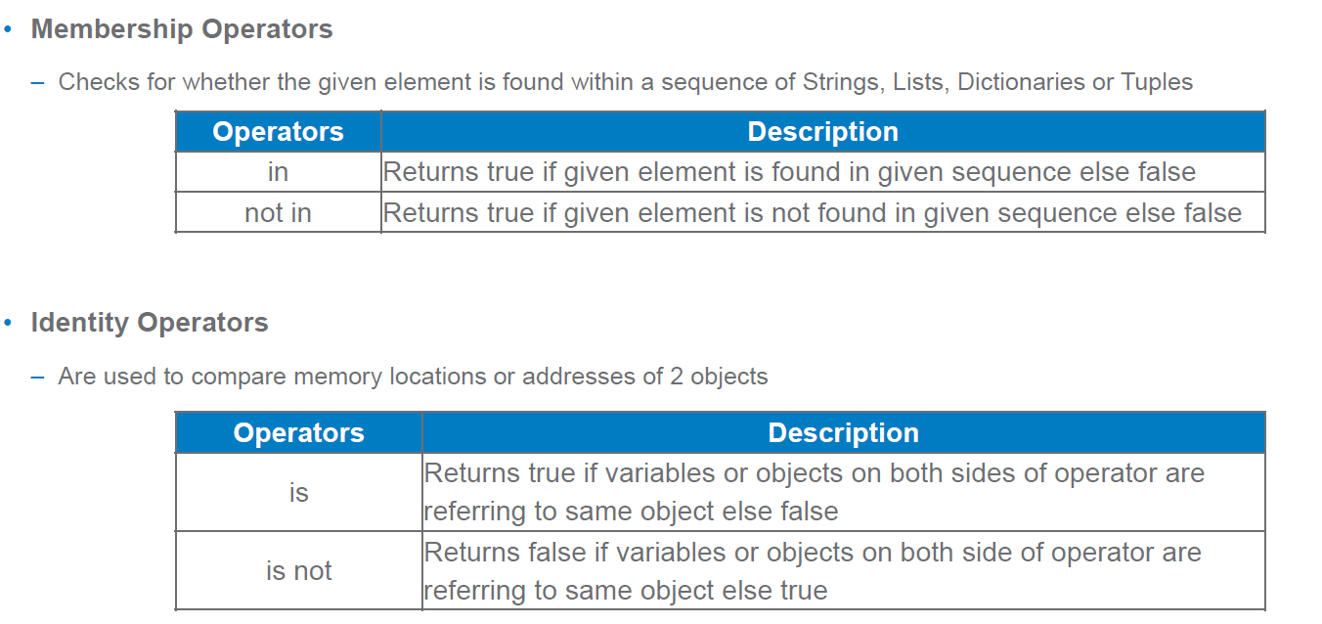
Membership and Identity Operators

Slide 33
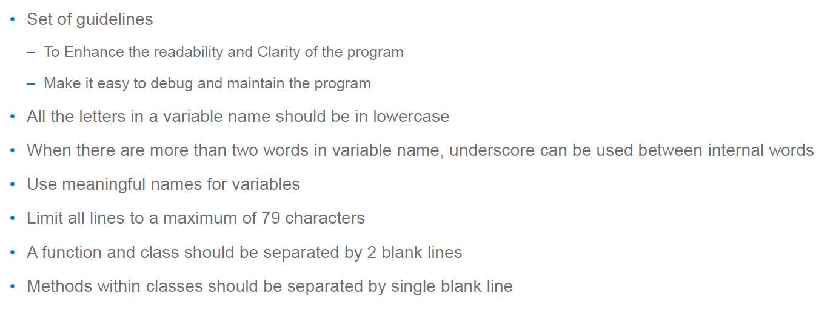
Coding Standards in python

Slide 34
Formatting output
There are several ways to present the output of a program, data can be printed in a human-readable form, or written to a file for future use. Sometimes user often wants more control the formatting of output than simply printing space-separated values. There are several ways to format output.
To use formatted string literals, begin a string with f or F before the opening quotation mark or triple quotation mark.
The str.format()method of strings help a user to get a fancier Output

Slide 36
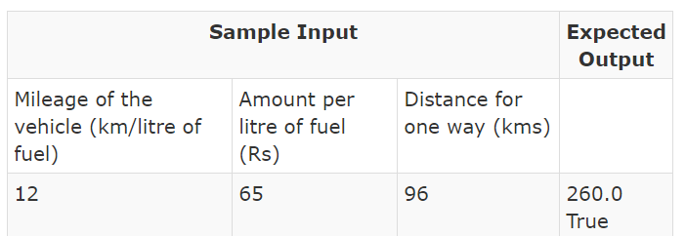
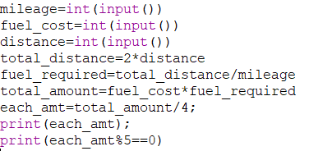
Simple Python codes
Jack and his three friends have decided to go for a trip by sharing the expenses of the fuel equally . Write a Python program to calculate the amount (in Rs) each of them need to put in for the complete (both to and fro) journey. The program should also display True, if the amount to be paid by each person is divisible by 5, otherwise it should display False. (Hint: Use the relational operators in print statement. Assume that mileage of the vehicle, amount per litre of fuel and distance for one way are given.

Slide 37


